Slide 1
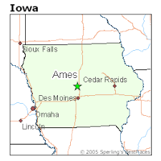
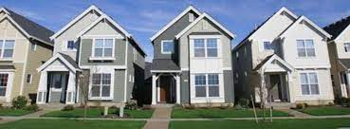

GA DSI Project 2
Ames Housing SalePrice Prediction
Team 3:
Maybelle,
Anand
Tiek Leong

Slide 2
Contents
Problem Statement
Data used
Feature Selection ⇒ Linear Regression (20 Features)
MultiCollinearity ⇒ Ridge Regression (16 Features)
Group Feature Selection, Polynomial feature engineering
ElasticNet (8 Features)
Demo
Limitations
Recommendations

Slide 3
Problem Statement
We are a start-up aiming to set up a Sale Price recommendation tool where users can use to get a recommended Sale Price with just a few details about their property for sale.
This webpage would have specific fields for users to fill property details and submit.
Using our proprietary machine learning algorithm, the web application generates a quote estimate for their property Sale Price.

Slide 4
Data used
Ames Iowa Housing Data 2006 - 2010
81 Features, 2051 data points
Target: Sale Price
Notes:
Just to give a brief overview on how we dealt the with the above data obtained we used data cleaning methods like dealing with null values, removing outliers. We also made statistical inferences, in some cases we conducted imputation of missing data and also data Scaling
Train and Test Data was obtained from Kaggle of over 2000 housing datapoints, in order to train and test a model. For each Id in the test set, we are required to predict the SalePrice of the corresponding houses. We imported the data using pandas and checked for missing data and outliers. Using the data dictionary, we went through the features and selected which ones were the most pertinent on Sale Price and addressed any underlying data quality issues.

Slide 5
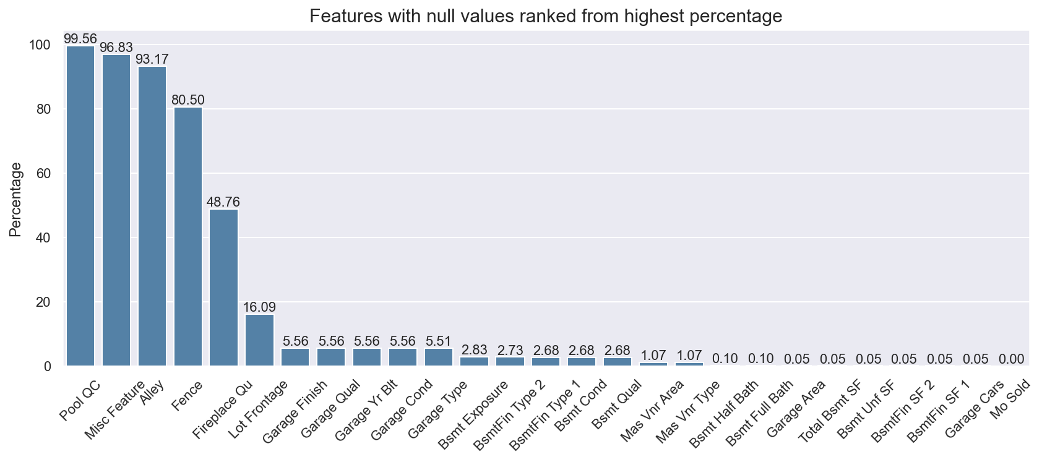
Missing Values
Noted that features with high percentage of null values, were meaningful null values
Garage Yr Blt feature dropped
Lot Frontage missing values will be imputed after train-test-split
Notes:
When dealing with with missing values, it is essential to look at the data dictionary provided in order to get a gauge of what features of the house the data indicates and will help on judgment calls on pertinence of particular house features on Sale Price
Most of the null values observed correspond to NA values, removing all rows with null values would be unwise as this would remove about 50% of the dataset

Slide 6
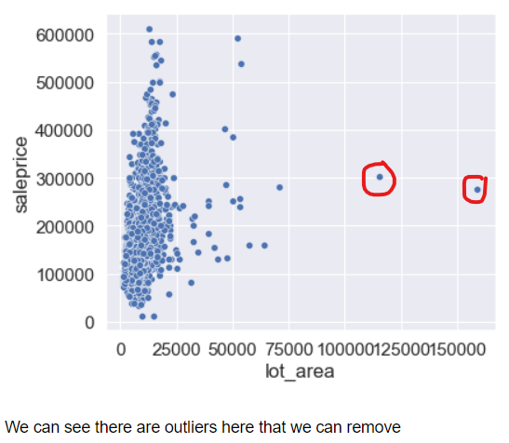
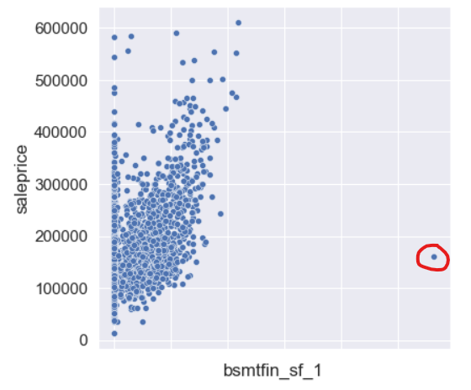
Outliers
Examples of Outlier Removal on certain features
Notes:
In this case we can see outliers exist that may skew the data, we removed them to make the model more reflective of actual trends

Slide 7
Label Encoding
We used ordinal encoding to reduce the number of features required for One-Hot encoding. E.g Lot Shape Reg=4, IR1=3, IR2=2, IR3=1
Superior attribute gets a higher score, to be consistent with Overall Qual and Overall Cond source encoding
New features to represent presence and absence of some features e.g. pool, fireplace, garage, alley
Notes:
In order to deal with ordinal values, we implemented label encoding in order to reduce the number of features that would eventually be used for modelling

Slide 8
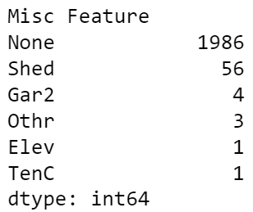
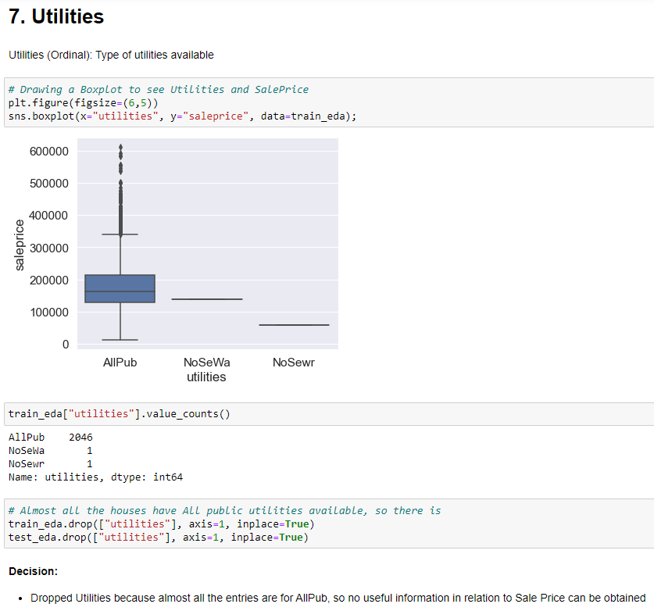
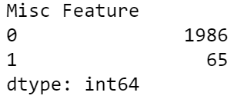
Value Count Grouping and Removal
Value Count Grouping
Feature Removal due to Value Count
E.g. Utilities
Notes:
These are 2 techniques we used during EDA, in the first case we see that a majority of Miscellaneous Features were none, so we labelled that as 0 and combined the rest of the value counts of shed and such under a label of 1. This helped to simplify the data where large value counts were occupied by 1 specific variable without compromising the data by removing it
The 2nd technique used here as an example was Utilities, where 99% of houses have access to Public Utilities therefore we can surmise that this does not really have a relevant impact on Sale Price, hence we decide to remove the feature of utilities entirely

Slide 9
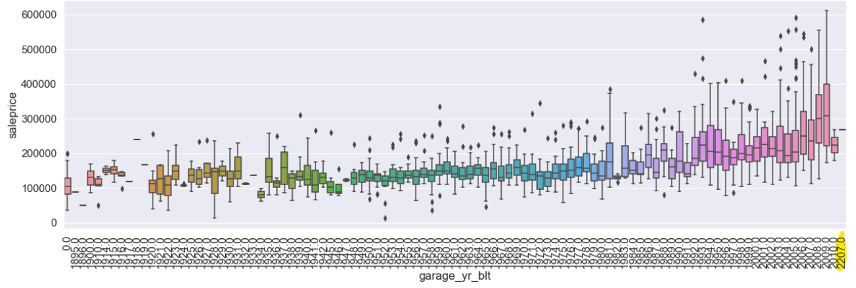
Removal of Data entry errors
Example: Garage Year Built Year 2207 removed
Notes:
Another example here is removing incorrect data, when we created a box plot for the Garage Year Built Feature, we can see that a Garage was built in the future year of 2207 which is impossible so we proceeded to remove that data point

Slide 10
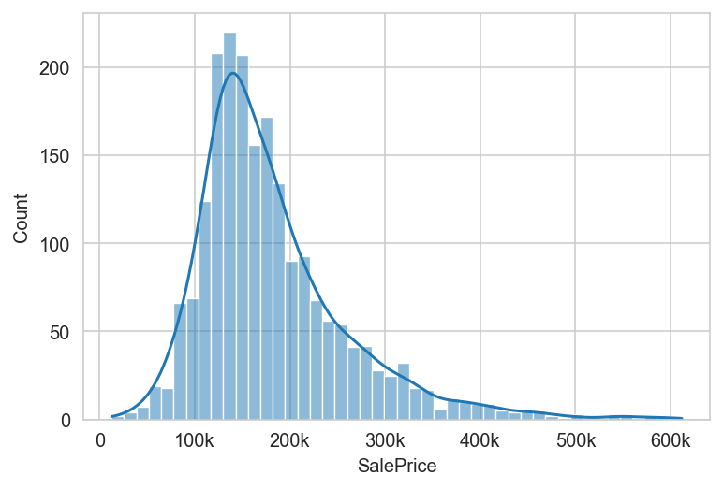
Target: SalePrice
Right-skewed distribution

Slide 11
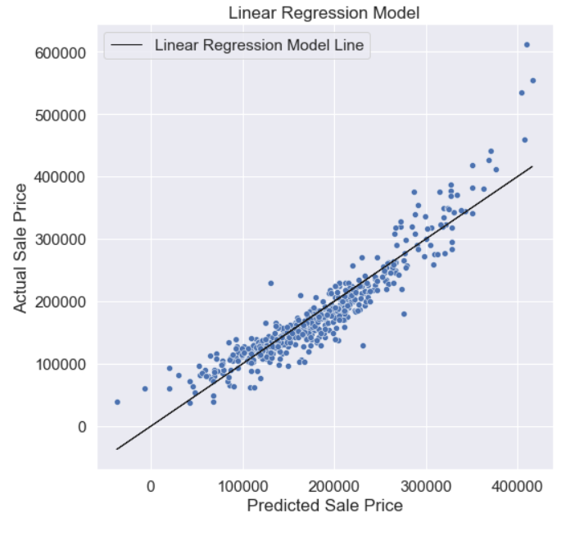
Modelling - Linear Regression (20 Features)
Features that had correlation ≥ 0.3 (p-value < 0.05) with Sales Price were retained
RMSE = root mean squared error
Baseline RMSE = 75639
Train RMSE = (25733)
Test RMSE = (25591)
% diff RMSE = 0.55%
Good generalisation. Performance better than baseline model.

Slide 12
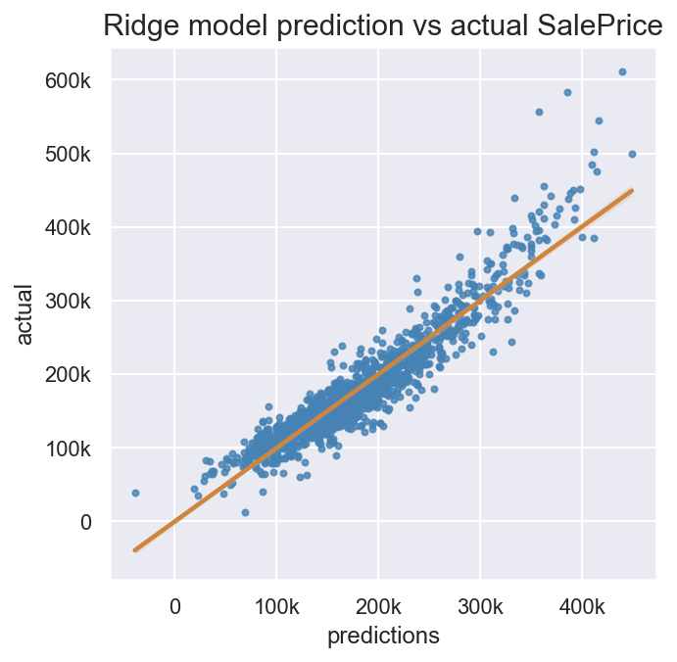
Modelling - GridSearch CV Ridge (16 Features)
To reduce multicollinearity, 4 features were dropped
Baseline RMSE = 75639
Train RMSE = (26766)
Test RMSE = (26666)
% diff RMSE = 0.37%
Good generalisation. Performance compromised slightly

Slide 13
Group Feature Selection
Found common features in all 3 of group members’ models, we further reduced the features used for model deployment
6 features found:
Overall Qual: Rates the overall material and finish of the house
Gr Liv Area: Above grade (ground) living area square feet
Total Bsmt SF: Total square feet of basement area
Garage Area: Size of garage in square feet
Year Built: Original construction date
Mas Vnr Area: Masonry veneer area in square feet

Slide 14
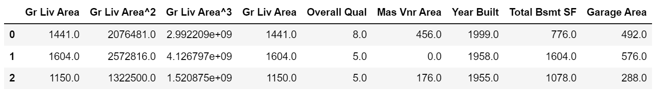
Polynomial Feature - Ground Living Area
Ground Living Area is the 2nd most correlated to SalePrice
Overall Qual will be imputed for new data because it is a subjective measure for our use case
Polynomial feature engineering more features resulted in overfitting

Slide 15
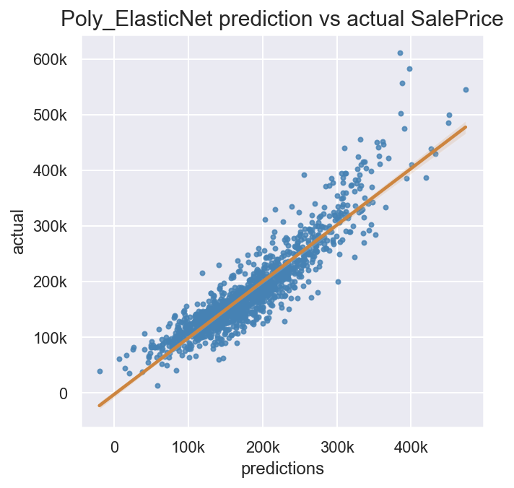
Modelling - GridSearch CV ElasticNet
(8 Features)
Mean Absolute Error (MAE)
Baseline RMSE = 75639
Train MAE = 21742
Test MAE = 22177
Test RMSE = (29884)
% diff RMSE = 1.84%
Generalisation is maintained. Compromised on performance.

Slide 16
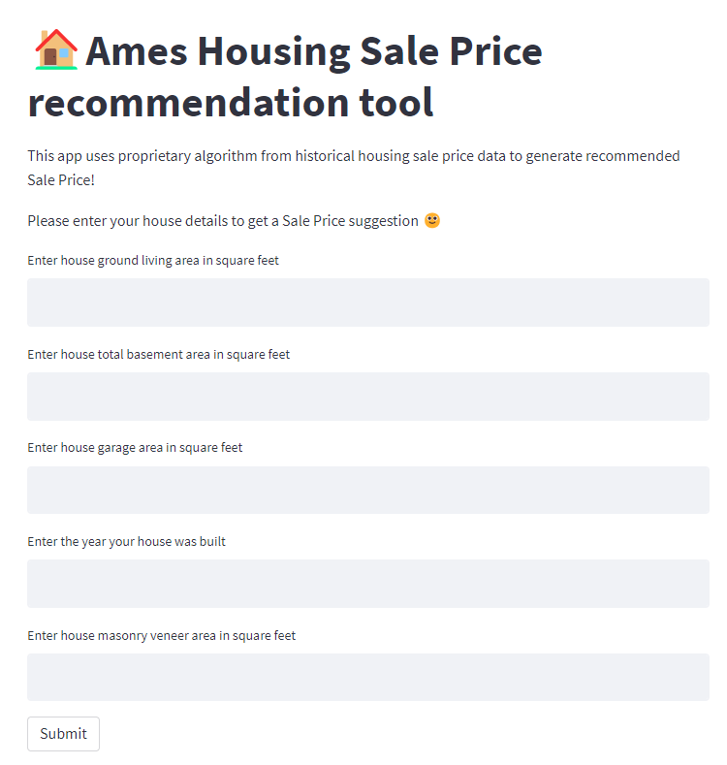
Demo
Streamlit Cloud link
Actual value: 164500
Recommended: 170965

Slide 17
Limitations
With SalePrice right skewed distribution - model has limited performance for recommendations above $400K.
Features with good predictive value for SalePrice tend to have high multicollinearity with each other.
This model does not take into account any economic or external factors that may affect Sale Price: for example, housing loan interest rates, unemployment figures, inflation, natural disasters etc.

Slide 18
Considerations
Years provided for data is from 2006 to 2010, which is over a decade old and may not reflect the current market figures and could result in stale data
All this data was taken during the 2008 financial crisis which could have implications on data quality
There could be other features not initially included in the raw training data that were not considered as we were limited to the data at hand e.g. Sale Condition

Slide 19
Recommendations
Although GridSearchCV ElasticNet linear model was chosen for deployment, we recommend trying different models to achieve better prediction performance
Collect more recent data (newer than 2010)
Collect more data points with house saleprices above $400k
Get access to Sale Condition feature
Collect data on other features not in current data that may have influence on house saleprice

Slide 20
Double Bam!!!
Any Questions?

Slide 21
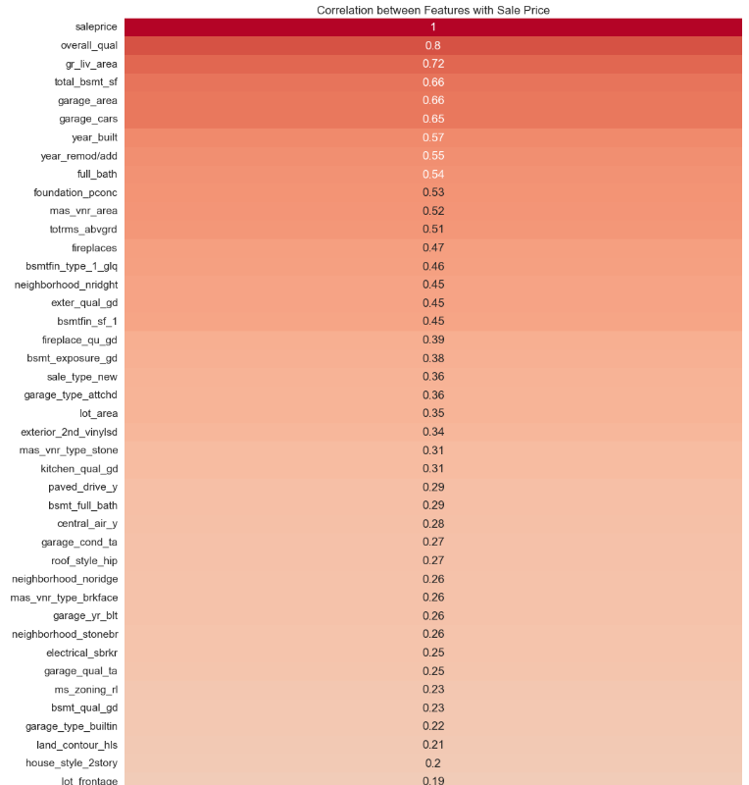
Correlation Heat Map between Features and Sale Price Pre - Feature Selection
Skipped
After Data Cleaning and processing, we have 138 features (Correlation heatmap on the left)
We conducted feature selection to reduce the number of features and to reduce multicollinearity

Slide 22
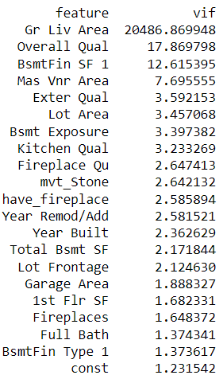
Correlation between features
Skipped
We used correlation heatmaps and Variation inflation factor scores to assess for multicollinearity between features.
We found VIF score being not very useful for feature selection for this dataset and target.
When all features with high VIF scores were removed, it results in a significantly poorer performing model
So we had to be selective with which feature to drop

Slide 23
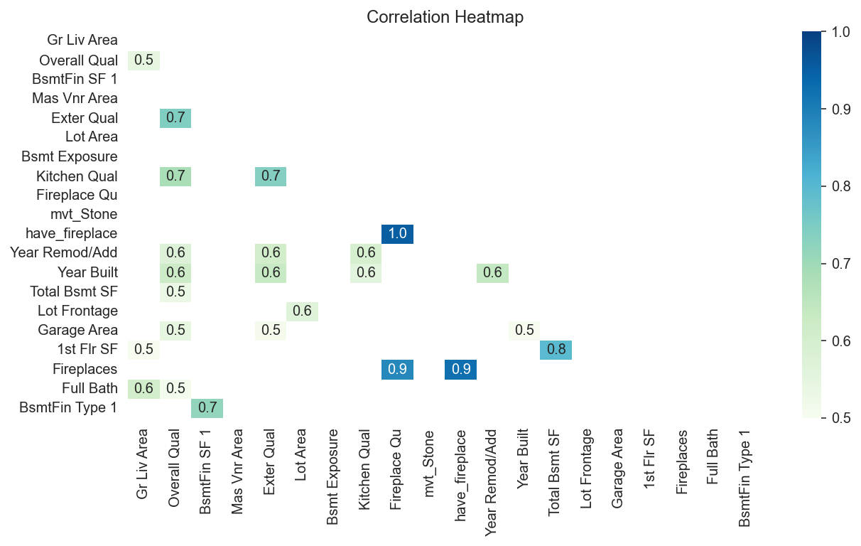
Correlation Heatmap
Skipped
have_fireplace, Fireplace Qu and Fireplaces have high correlation
BsmtFin SF 1 has high VIF score and low correlation with SalePrice
Total Bsmt SF and 1st Flr SF have high correlation with SalePrice, so they were not dropped

